Slide 1
Identification Week 2

Slide 2
What is data?
Notes:
Based on the readings

Slide 3
Data is…
a collection of discrete or continuous values that convey information, describing the quantity, quality, fact, statistics, other basic units of meaning, or simply sequences of symbols that may be further interpreted formally.

Slide 4
Data is…
a collection of discrete or continuous values that convey information, describing the quantity, quality, fact, statistics, other basic units of meaning, or simply sequences of symbols that may be further interpreted formally.

Slide 5
Data is…a collection
What do we mean by collection?

Slide 6
Data is…a collection
What do we mean by collection?
Verb
How is it gathered?
Manually, automatically
Noun
What is the format?
Spreadsheet
Database
Raw vs organized

Slide 7
Data is…a collection of basic units of meaning
What do we mean by basic units of meaning?
Notes:
Here are the examples of types of meaning you could have

Slide 8
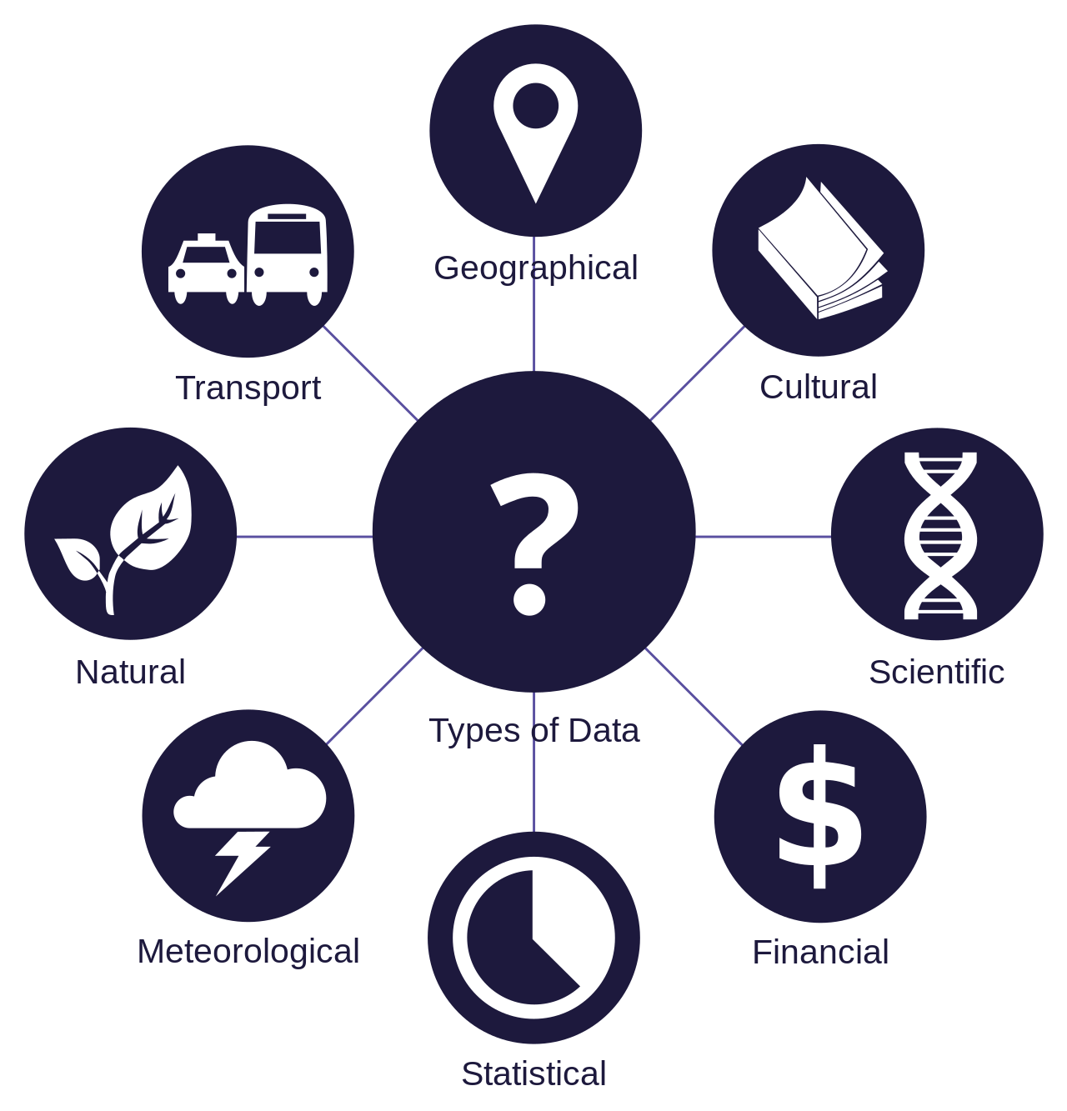
Data is…a collection of basic units of meaning
Notes:
Here are the examples of types of meaning you could have

Slide 9
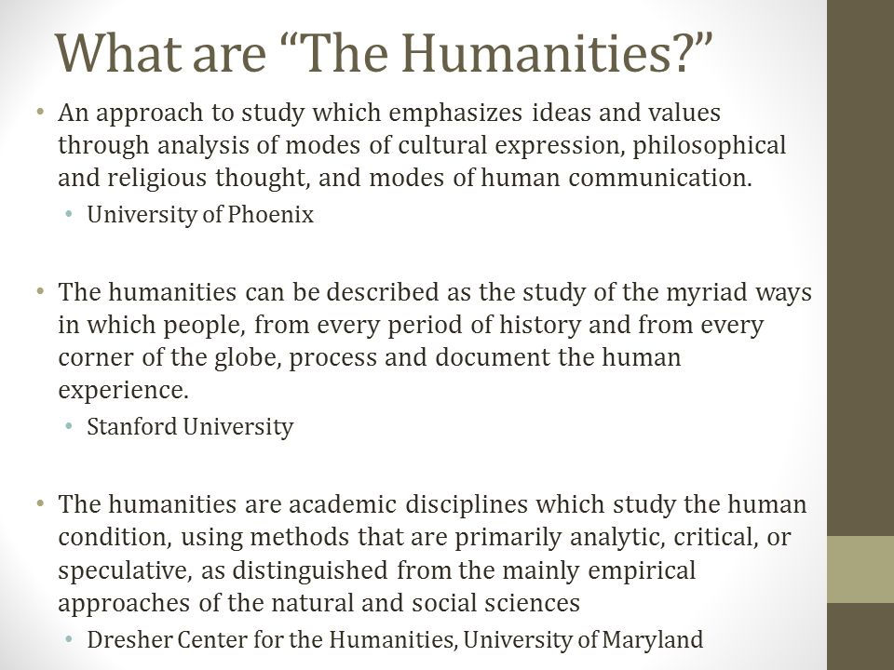
Notes:
https://slideplayer.com/slide/10513247/

Slide 10
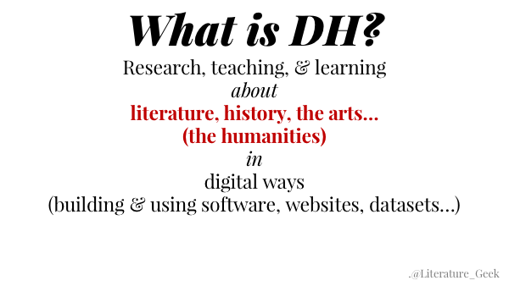

Slide 11
Data is…a collection of basic units of meaning
Notes:
Here are the examples of types of meaning you could have

Slide 12
Data is…a collection of basic units of meaning
But what might that look like?
Notes:
Here are the examples of types of meaning you could have

Slide 13
Data is…a collection of basic units of meaning
Numbers
Words
Dates
Characteristics
Data about the data itself – metadata
Other things?

Slide 14
Data…may be further interpreted formally
What do we mean by this?

Slide 15
Data…may be further interpreted formally
Why use a computer to interpret data?
Fast
Scale
What does analysis look like?
Quantitative vs qualitative
Computers lack nuance
Need careful formatting to analyze
Particularly challenging with humanities stuff!

Slide 16
Altogether…
Data is a collection of basic units of meaning, that may be further interpreted formally.
With that in mind, how does that apply to the thing you produced last week?
What is humanities data, especially?
What have your readings told you?

Slide 17
What is not data?
Notes:
Open discussion based on the readings

Slide 18
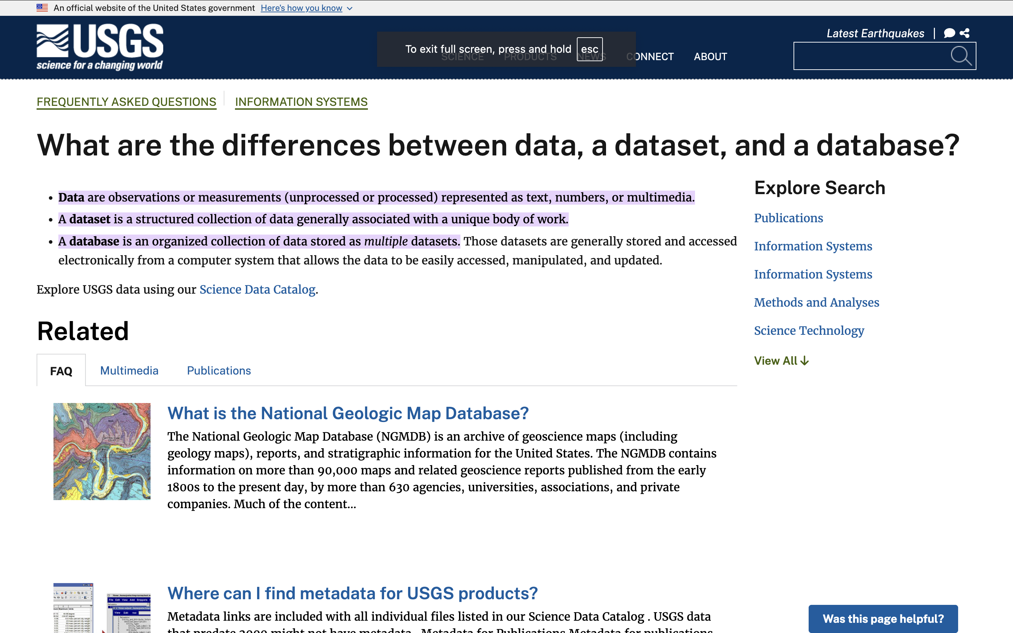

Slide 19
Workshop: Data or Not?
Going to show you a series of things
Questions to answer:
Is it data or not?
Why or why not?
If the answer is no, what does it need to become data?
Remember our checklist:
Collection
Of units of meaning
That can be interpreted formally
Notes:
Examples will be…business data, book, spreadsheet, empty spreadsheet, movie poster, series of movie posters, database, collection of sentences, fitbit, phone calls from the NSA

Slide 20
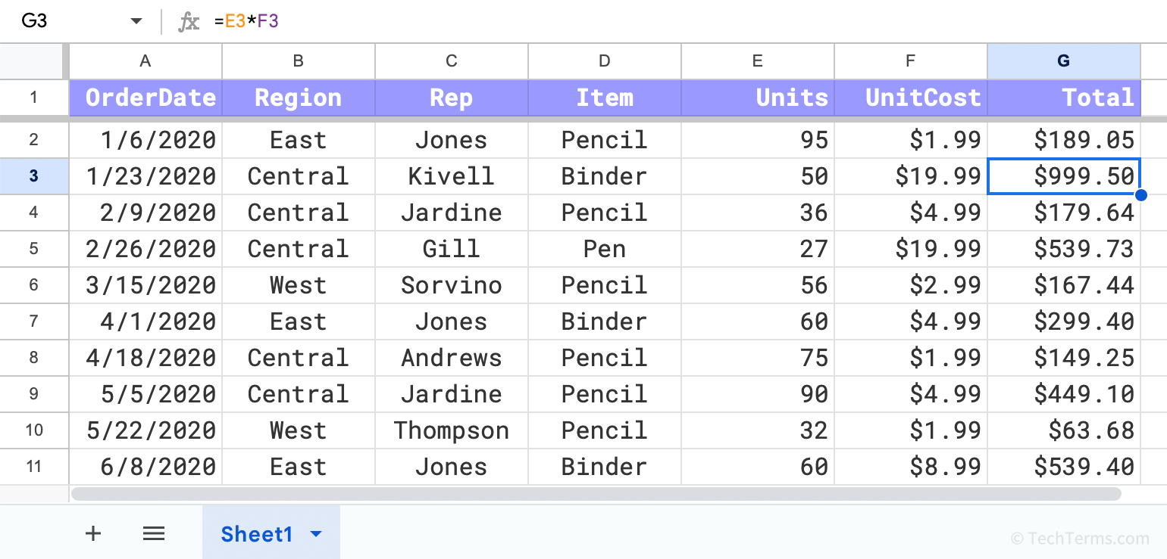
Workshop: Data or Not?
Notes:
From https://techterms.com/definition/spreadsheet

Slide 21
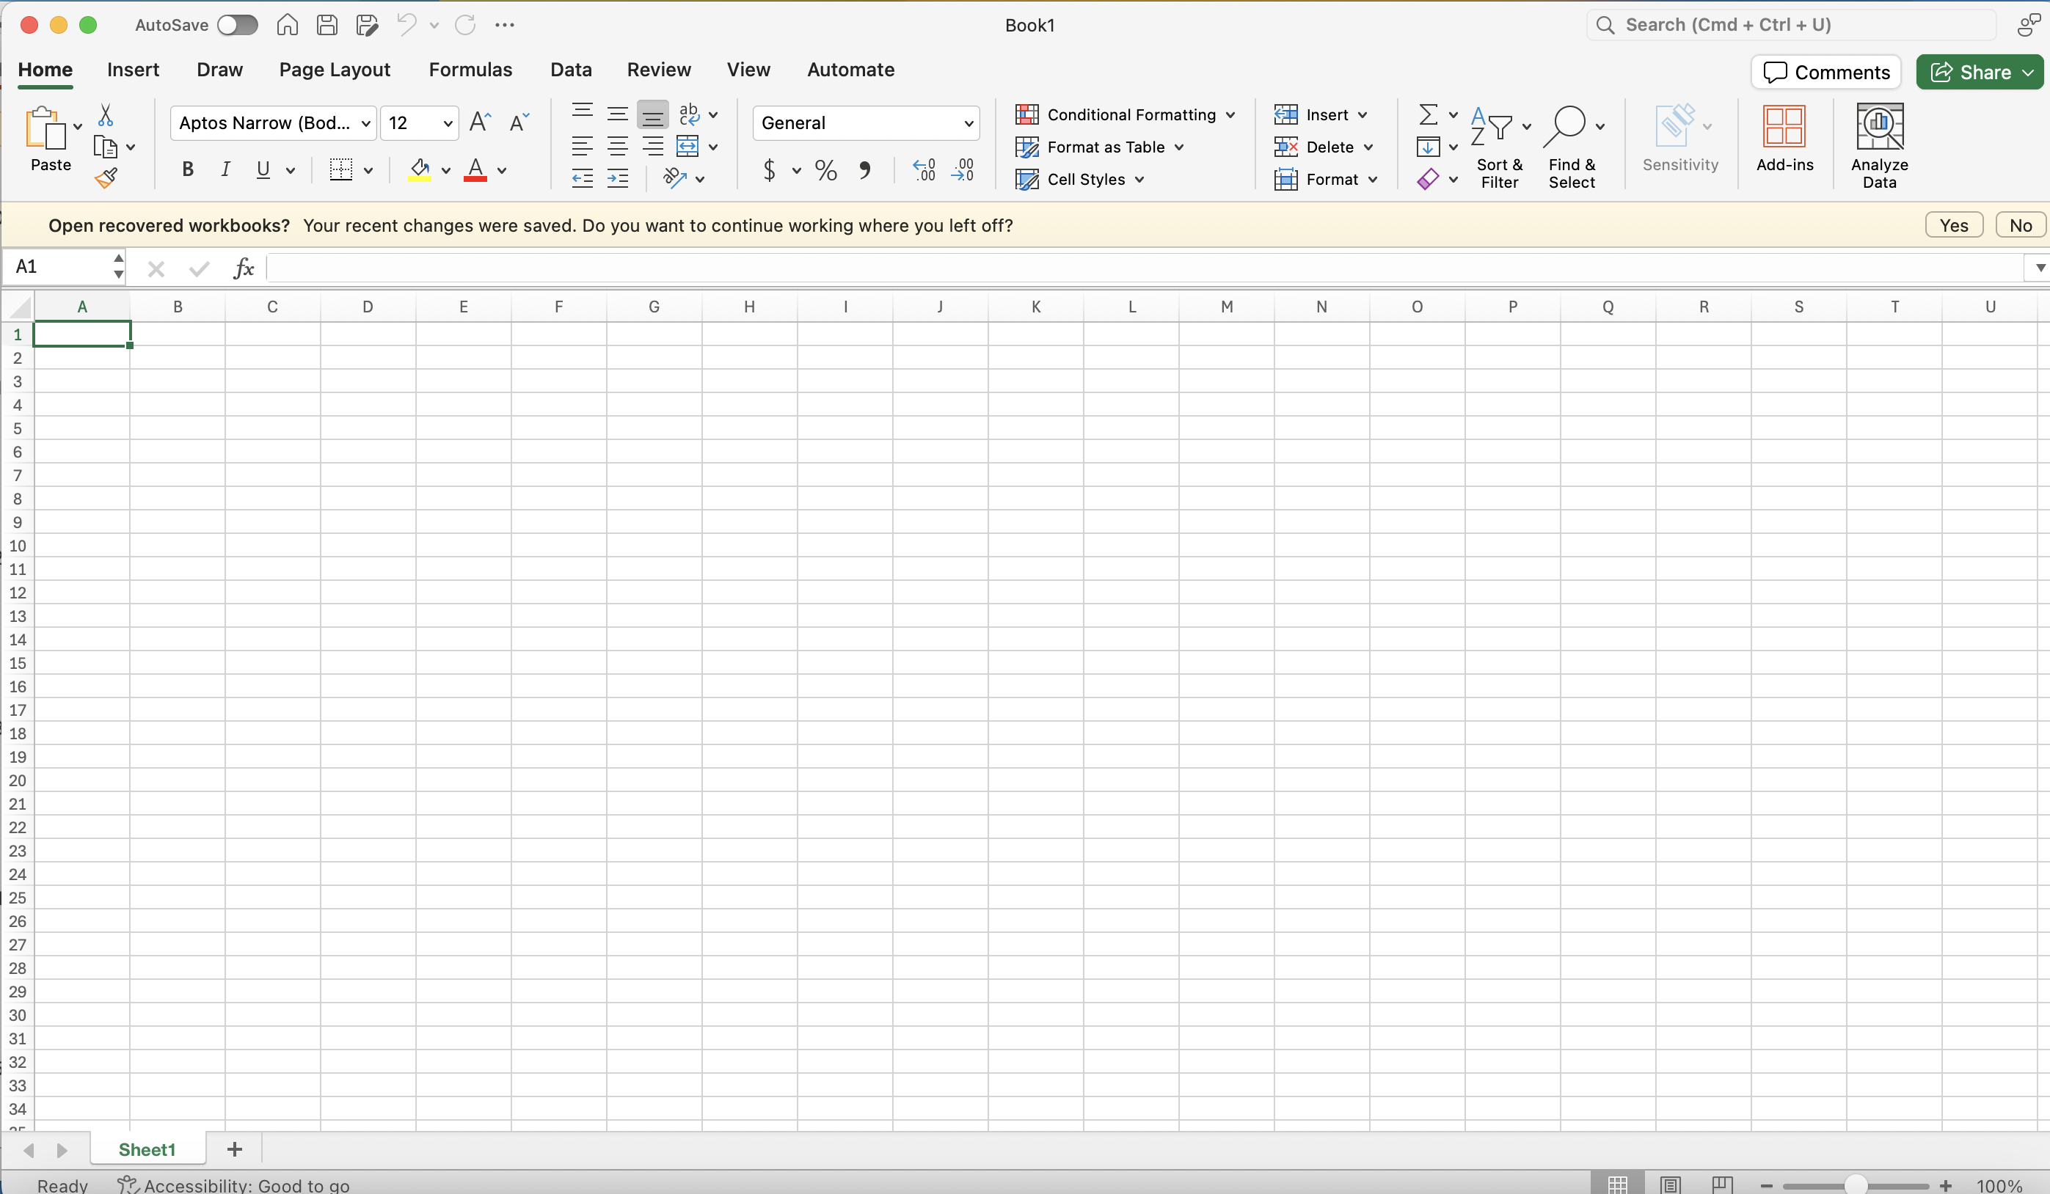
Workshop: Data or Not?
Notes:
Examples will be…business data, book, spreadsheet, empty spreadsheet, movie poster, series of movie posters, database, collection of sentences, fitbit, phone calls from the NSA

Slide 22
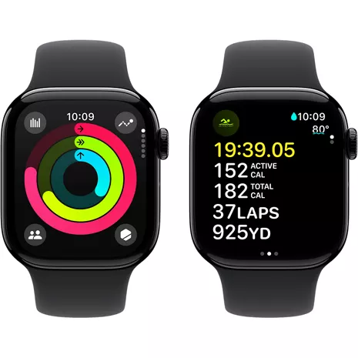
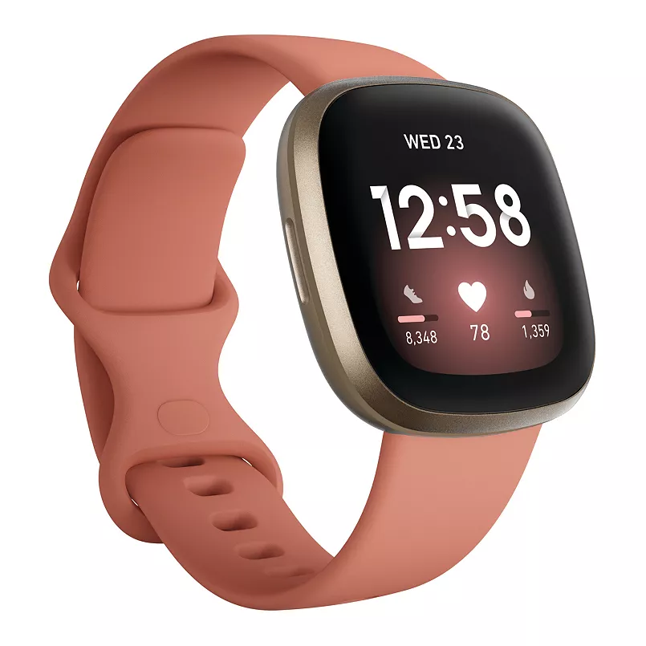
Notes:
Examples will be…business data, book, spreadsheet, empty spreadsheet, movie poster, series of movie posters, database, collection of sentences, fitbit, phone calls from the NSA

Slide 23
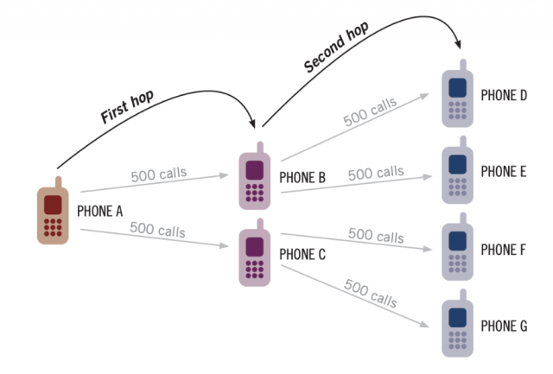
Notes:
https://cdt.org/insights/the-nsa-shuttered-the-call-detail-records-program-so-too-must-congress/

Slide 24
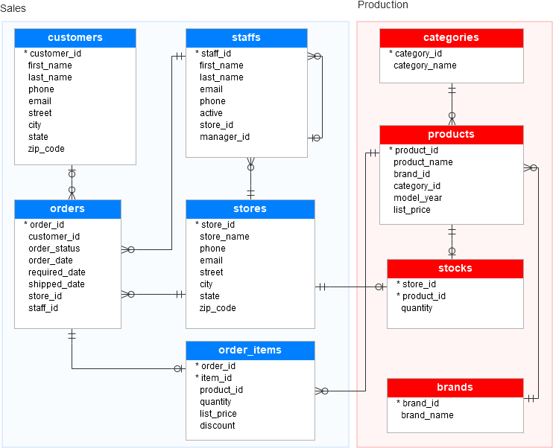
Notes:
https://www.sqlservertutorial.net/getting-started/sql-server-sample-database/

Slide 25

Workshop: Data or Not?
Examples will be…book
Notes:
https://unsplash.com/photos/books-on-brown-wooden-shelf-Ft_Wn-K5YH8

Slide 26
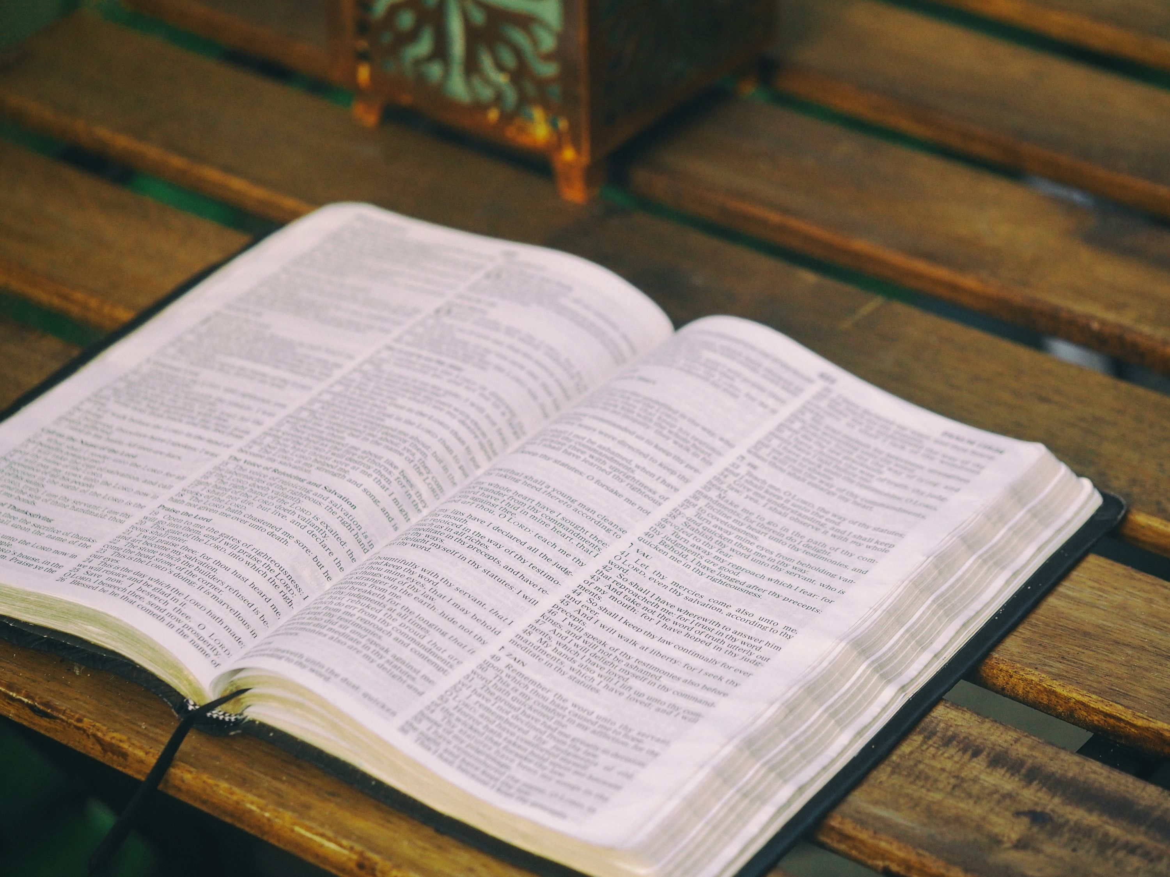
Workshop: Data or Not?
Notes:
https://unsplash.com/photos/bible-opened-on-table-Qj3DC6ifJMM

Slide 27
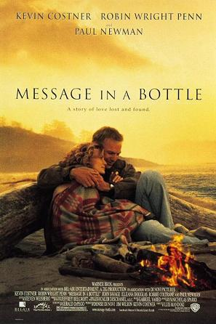
Notes:
Examples will be…business data, book, spreadsheet, empty spreadsheet, movie poster, series of movie posters, database, collection of sentences, fitbit, phone calls from the NSA

Slide 28
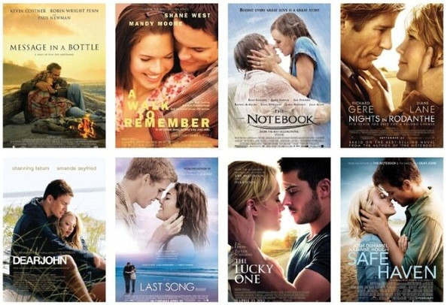
Workshop: Data or Not?
Examples will be…series of movie posters
Notes:
https://moviesfilmsandflix.com/2016/06/20/movienomics-analyzing-the-face-palming-world-of-nicholas-sparks-movie-posters/

Slide 29
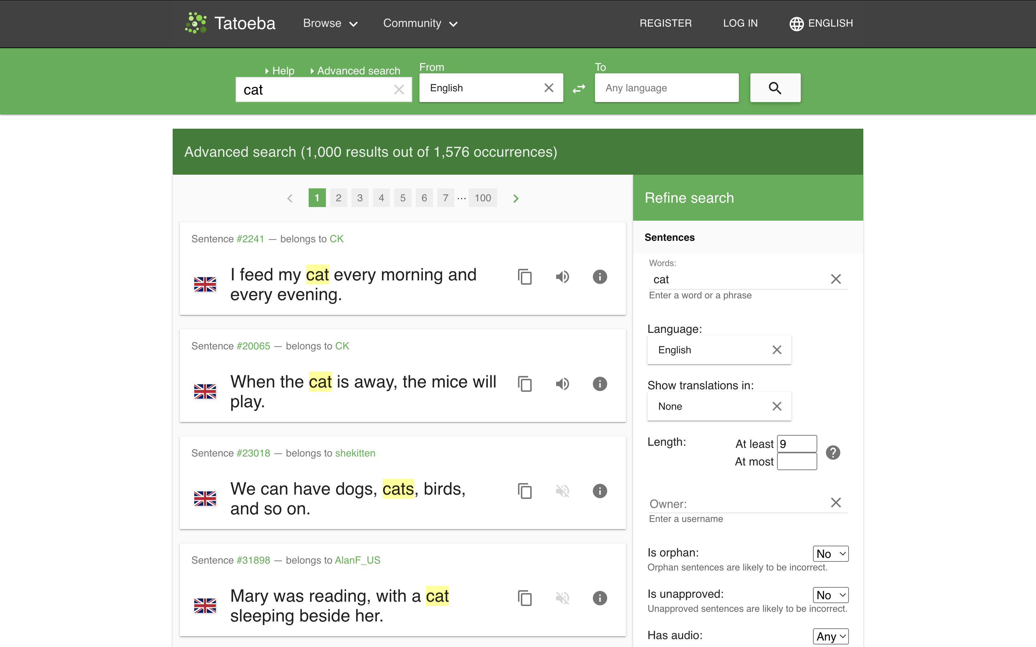
Workshop: Data or Not?
collection of sentences
Notes:
https://tatoeba.org/en/sentences/search?from=eng&has_audio=&native=&orphans=no&query=+cat&sort=relevance&sort_reverse=&tags=&to=none&trans_filter=limit&trans_has_audio=&trans_link=&trans_orphan=&trans_to=&trans_unapproved=&trans_user=&unapproved=no&user=&word_count_max=&word_count_min=9

Slide 30
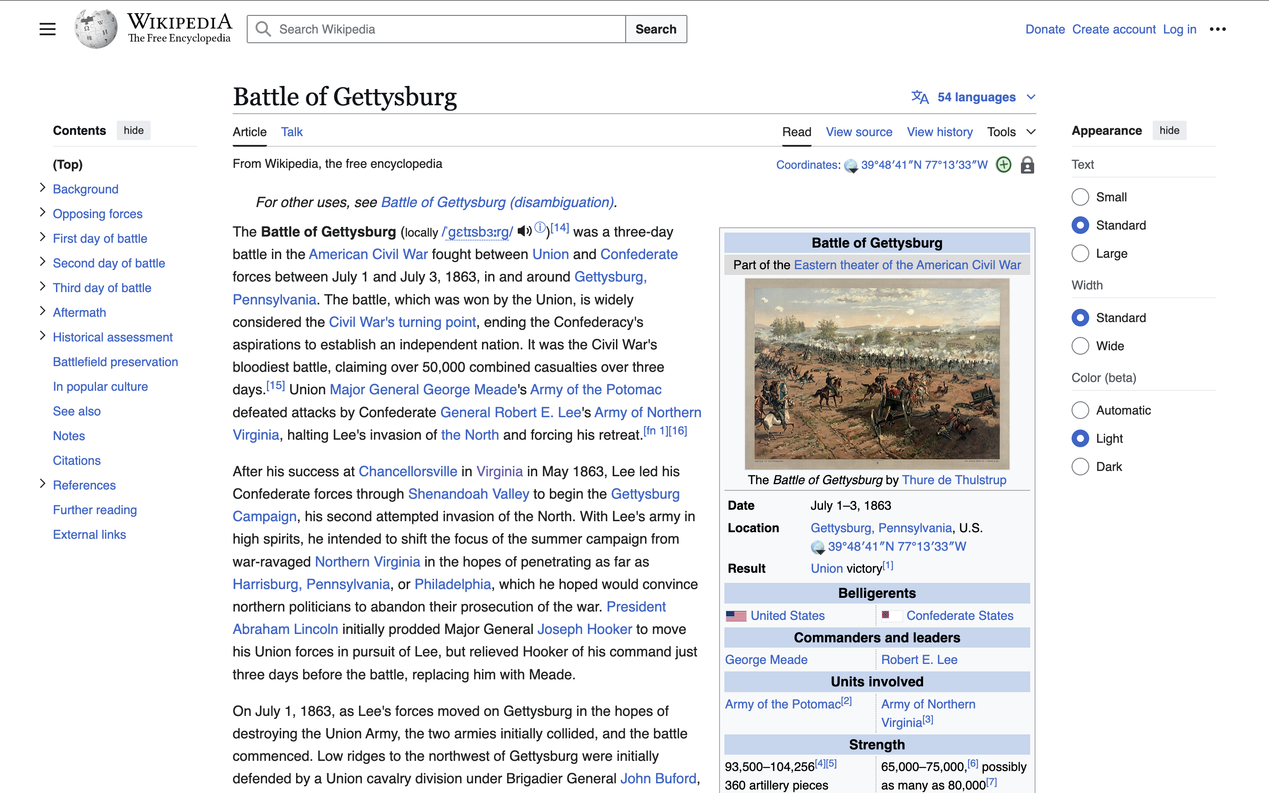
Notes:
https://cdt.org/insights/the-nsa-shuttered-the-call-detail-records-program-so-too-must-congress/

Slide 31
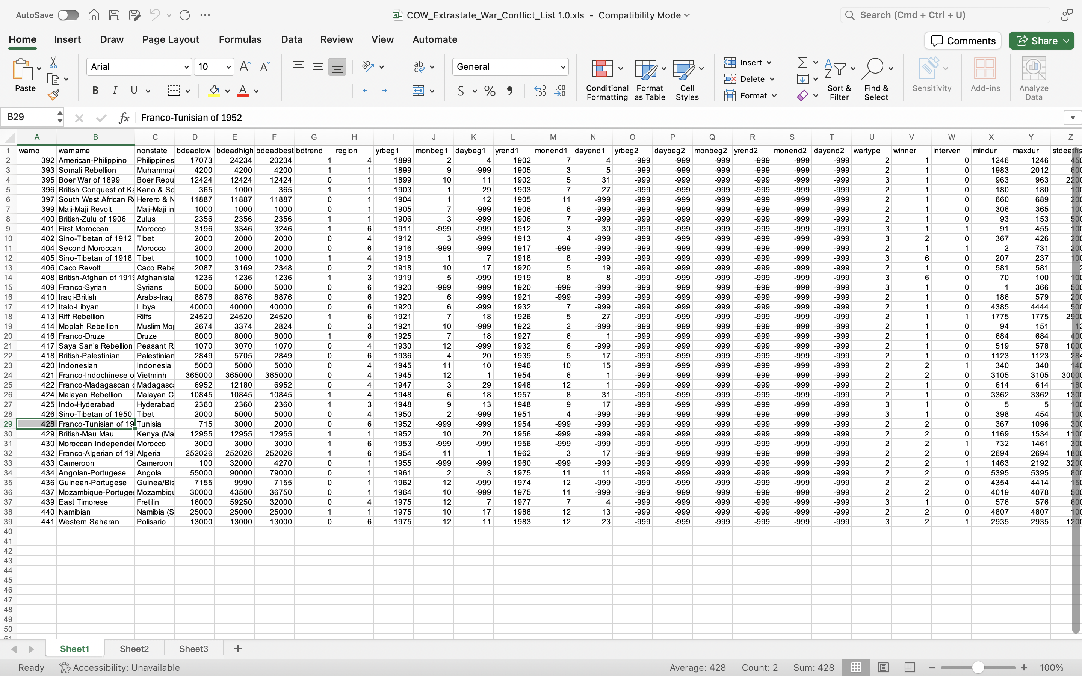

Slide 32


Slide 33
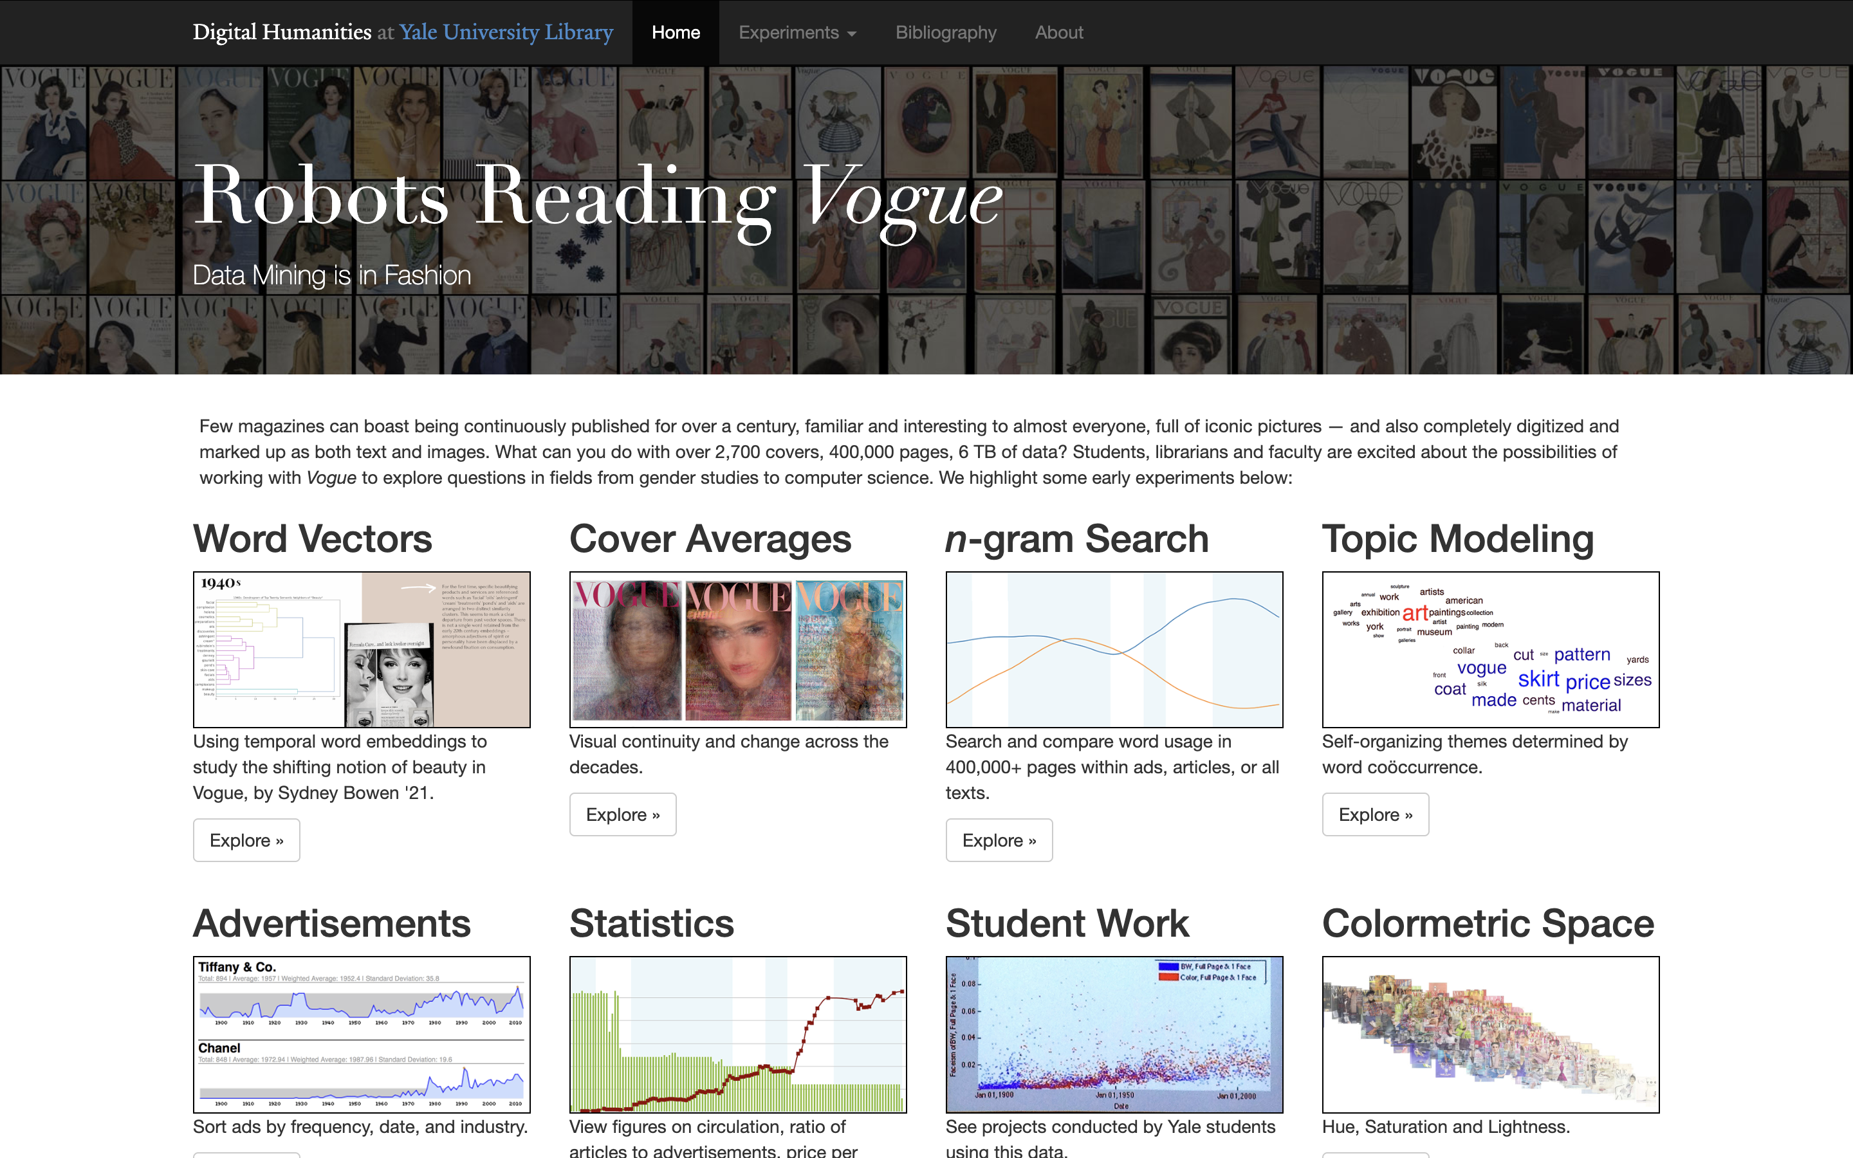
Notes:
http://dh.library.yale.edu/projects/vogue/colormetricspace/

Slide 34
What is there? What is missing?
What did you notice?
What seems to exist? To not?
What are some ethical considerations in making new datasets?
What are some examples of things in everyday life, particularly cultural objects, that you might encounter in new ways as data?
Notes:
Open discussion of the missing datasets
What did they notice?
What kind of personal datasets don’t exist?
How to determine what you can’t see? What kind of ethical considerations are there about making new datasets?
What are some examples of things in your everyday life that you encounter in new and different ways if you can consider them data?
Maybe a bit more time on the missing part here.

Slide 35
Other Questions?
Homework for Friday:
Brainstorm a list of three datasets that don't seem to exist that you might be interested in. Give each one a 4-5 sentence description. Bonus points if they are related to the humanities in some way. Send your list to me by Friday at 9:00 AM.

